Slide 1

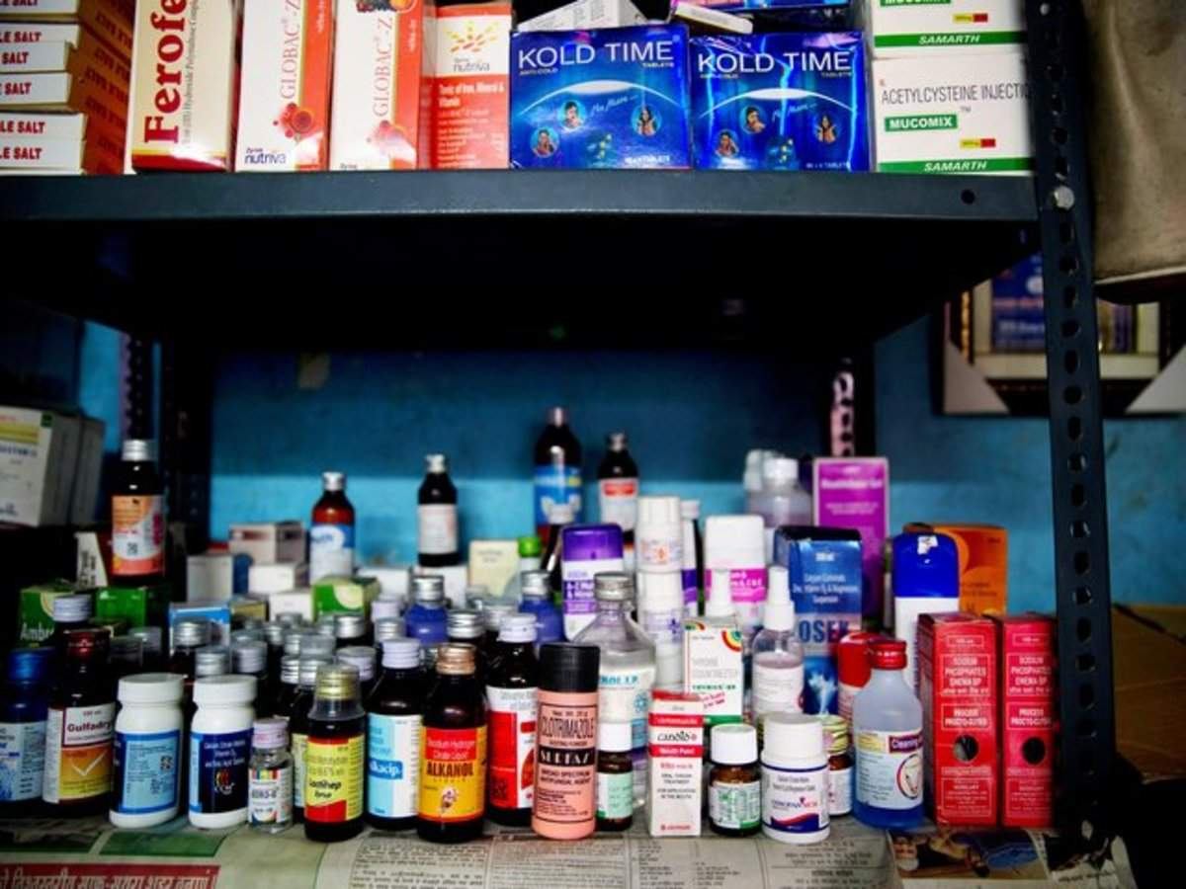
Dr. Reddy’s website
Background of the company
Criteria
Description
The company was founded by Kallam Anji Reddy. It started its operation in 1984 in the Active Pharmaceutical Ingredients (API) segment, with a single drug in 60 tonne facility near Hyderabad.Dr. Reddy's manufactures and markets a wide range of pharmaceuticals in India and overseas.It is among the top three API players in world.
Criteria 1
They believe that good health must be delivered speedily to as many patients as possible. They target therapy areas with unmet patient needs and aim to create accessible and affordable solutions.
Evidence-Sustainability Report
Criteria 2
The drugs it makes just provide benefit to customers. Recently, it has released a drug to treat opioid dependence.
Evidence-Opioid Addiction
Criteria 6
The manufacturing operations of pharmaceuticals indeed comes with a harm to the society, so in order to offset them, Dr.Reddy’s has adopted many methods.
Evidence-Environmental Management
Criteria 8
Dr. Reddy’s buys and sells from companies that are also customer centric and socially ethical, viz. Novartis India.
Evidence-Collaboration with Company
Product/ service
Characteristics
Their dynamic business offers opportunities for driven, ambitious people with diverse skill-sets people who want to make a difference in patients’ lives.
They leverage their research and development expertise, end-to-end manufacturing know-how and progressive digital technology to deliver on their promises to patients around the world.
Photo of the product / servce

